Slide 1
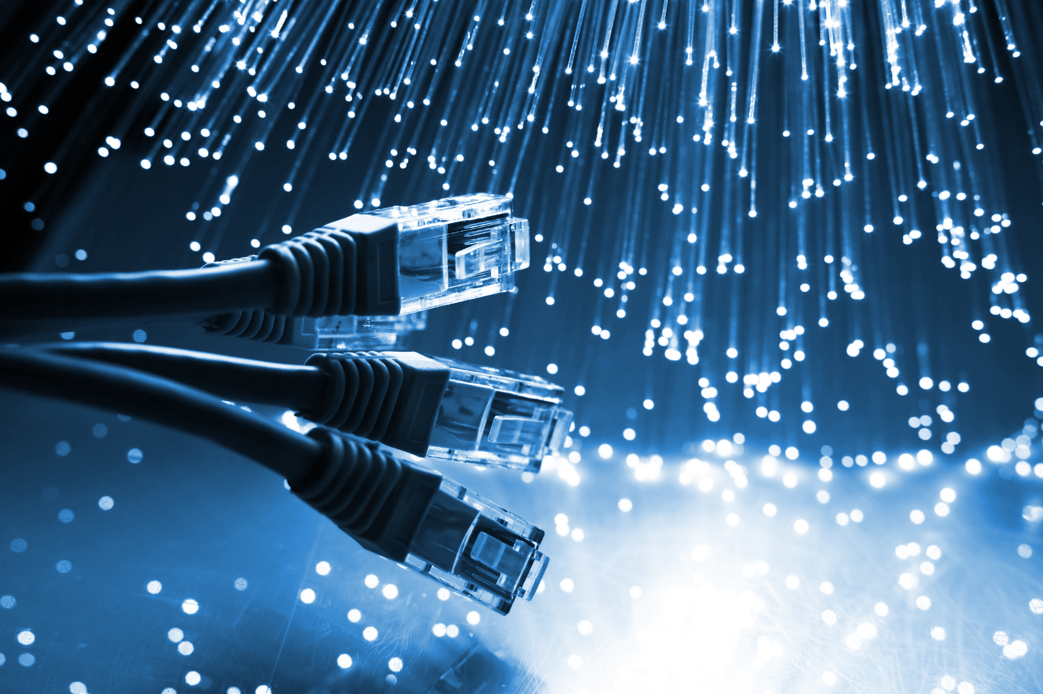

Network concepts
1
Network concepts

Slide 2
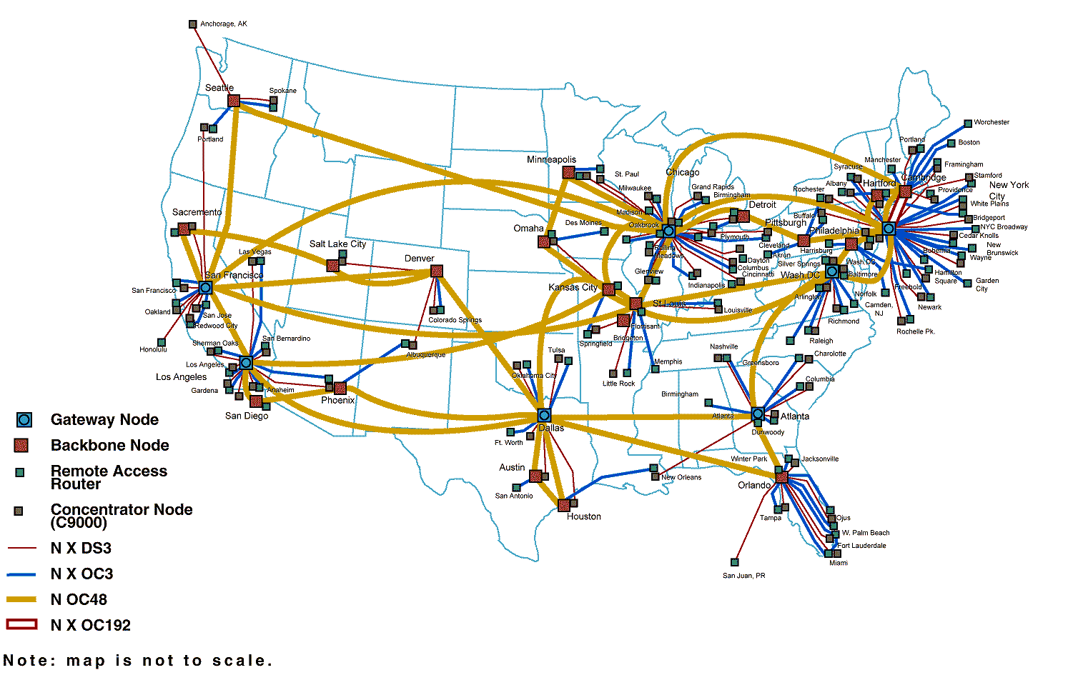
What is a network, generally speaking?
A network is formed of nodes connected by links.
carries data
emits/receives/relays data
nodes
links
2
Network concepts

Slide 3
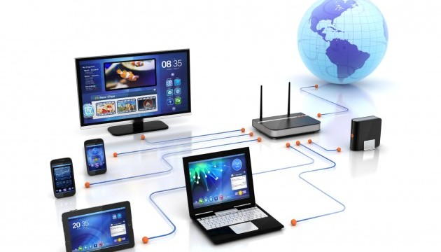
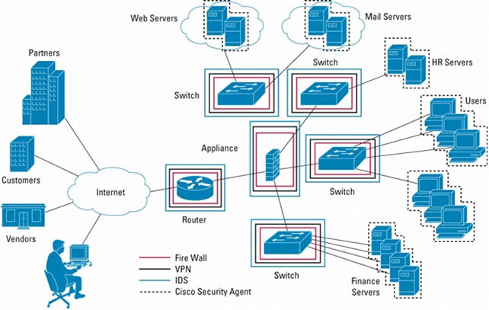
What is a network, generally speaking?
A network is formed of nodes connected by links.
Any network can be conceptualized that way: home, enterprise, backbone...
links don’t have to be physical, data can be carried wirelessly too
3
Network concepts

Slide 4
How do networks speak?
The laptop speaks to the router in a very defined way in order to send or get data.
Rules defining how nodes work together to move data are called network protocols.
4
Network concepts

Slide 5
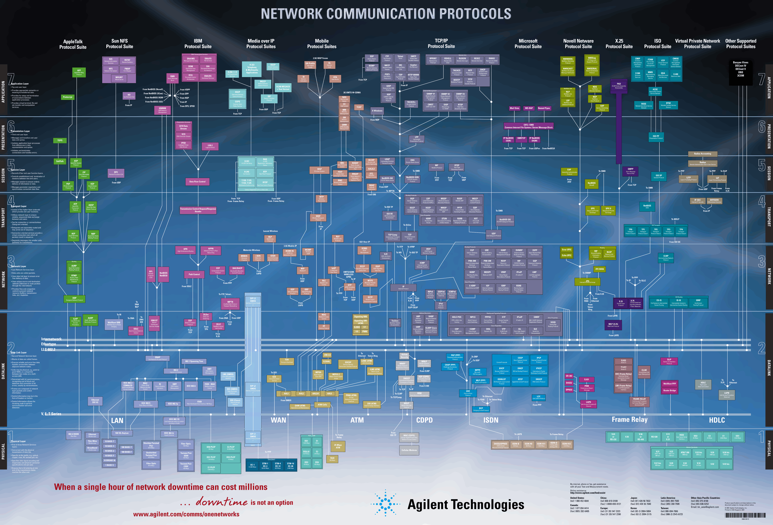
There are lots of protocols. But at least they are organized into layers!
The Open Systems Interconnection (OSI) reference model has 7 layers
5
Network concepts

Slide 6
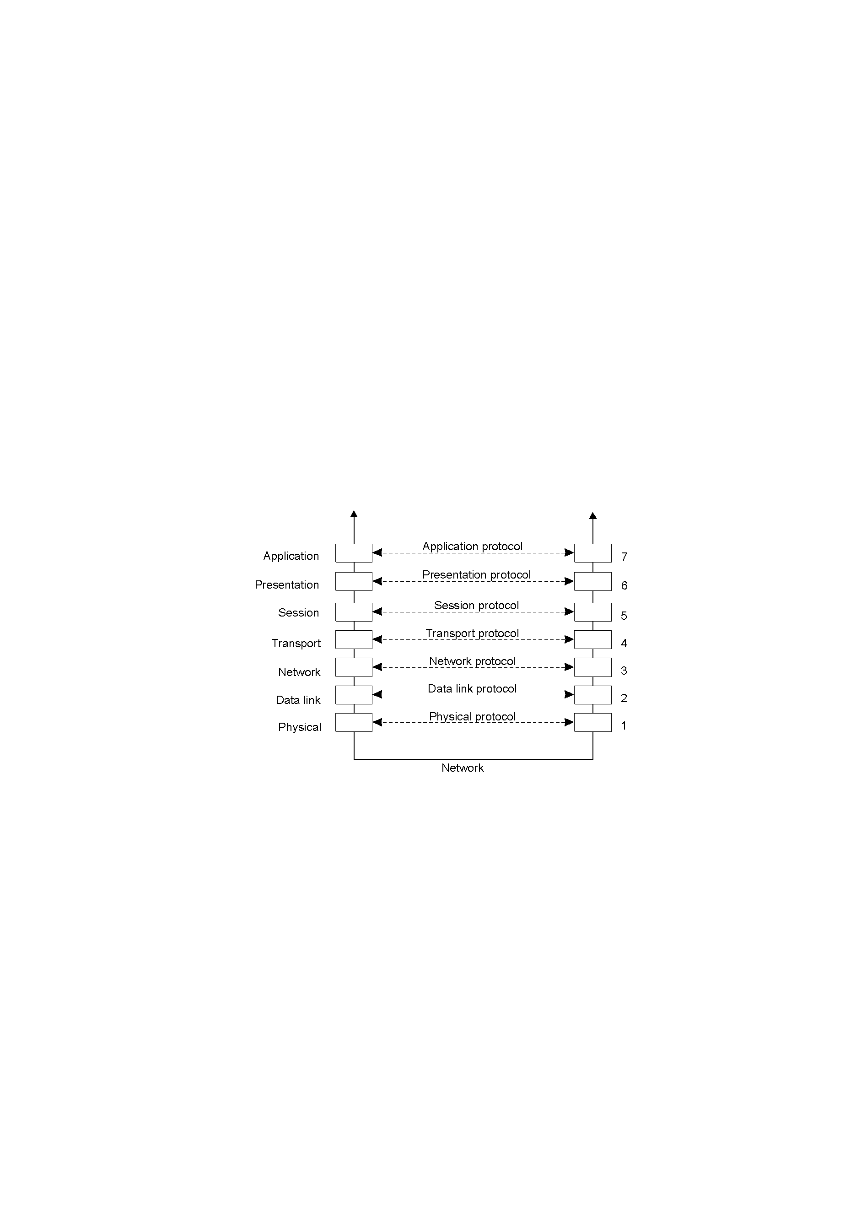
How do networks speak?
High-level services
Makes data app-usable
Manages the connection
Ensures data moves over network
Moves data between nodes
Ensures data moves over link
Raw bit stream transmission
6
Network concepts

Slide 7
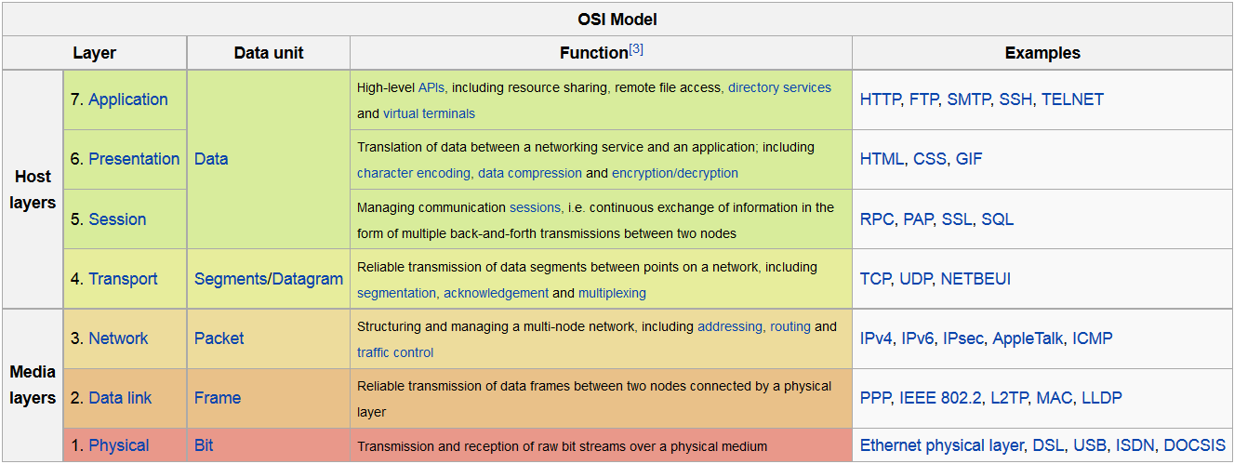

How do networks speak?
7
Network concepts

Slide 8
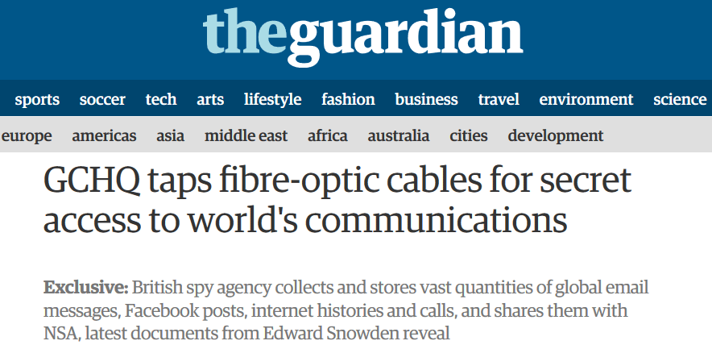

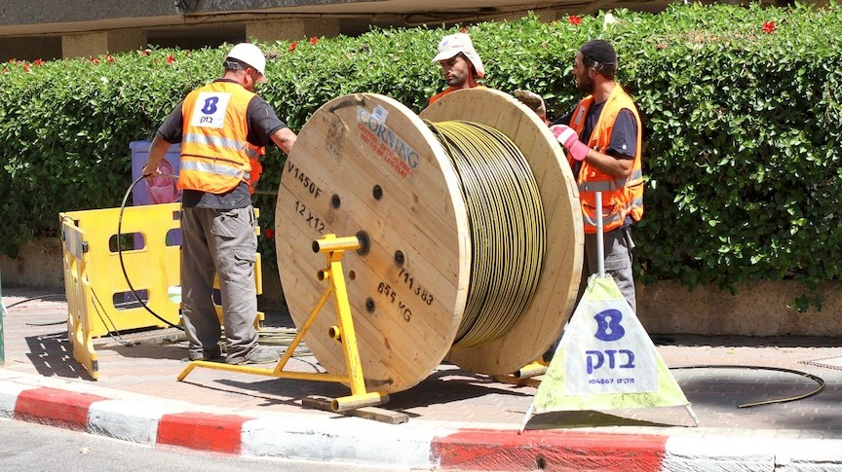

How do networks speak?
Fiber optic
8
Network concepts

Slide 9
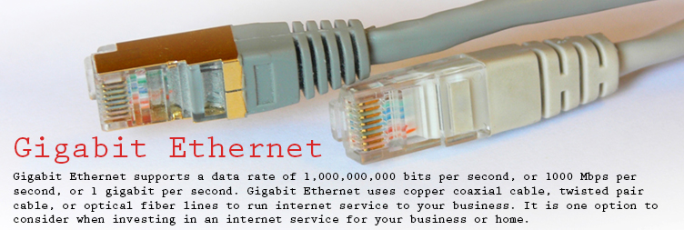
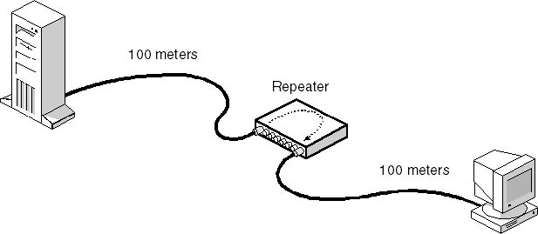
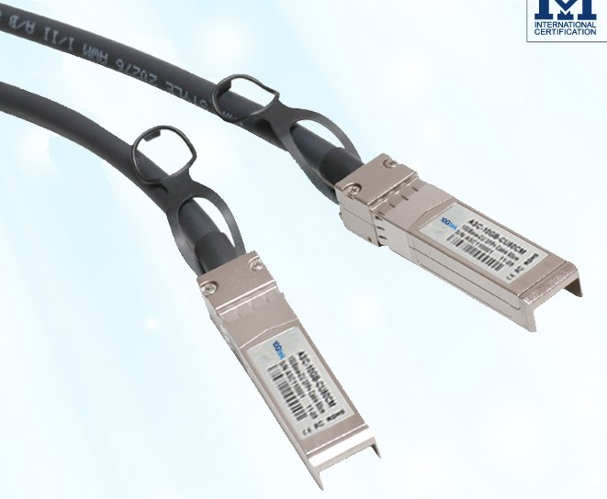
How do networks speak?
Ethernet cables
10 Gb
9
Network concepts

Slide 10
How do networks speak?
Cellphone e.g. 4G LTE, ≈ 50 Mbps
WiFi: 20-100 Mbps
Tier 1 Backbone:
≈ 100 Gbps. Records for fiber networks in research labs are about ≈255 Tbps
(R.G.H. van Uden et al, Ultra-high-density spatial division multiplexing with a few-mode multicore fibre, Nature Photonics 2014)
10
Network concepts

Slide 11
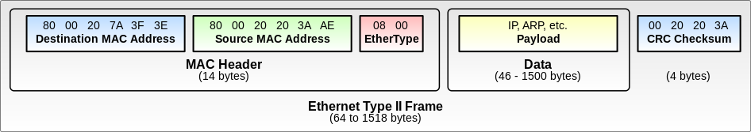
How do networks speak?
E.g.: Ethernet frame
Preamble | Destination | Source | Type | User data | Frame check sequence
We give the Media Access Control (MAC) address. It is a unique identifier for network interfaces used for the IEEE 802 standard (Ethernet, Wifi...)
11
Network concepts

Slide 12
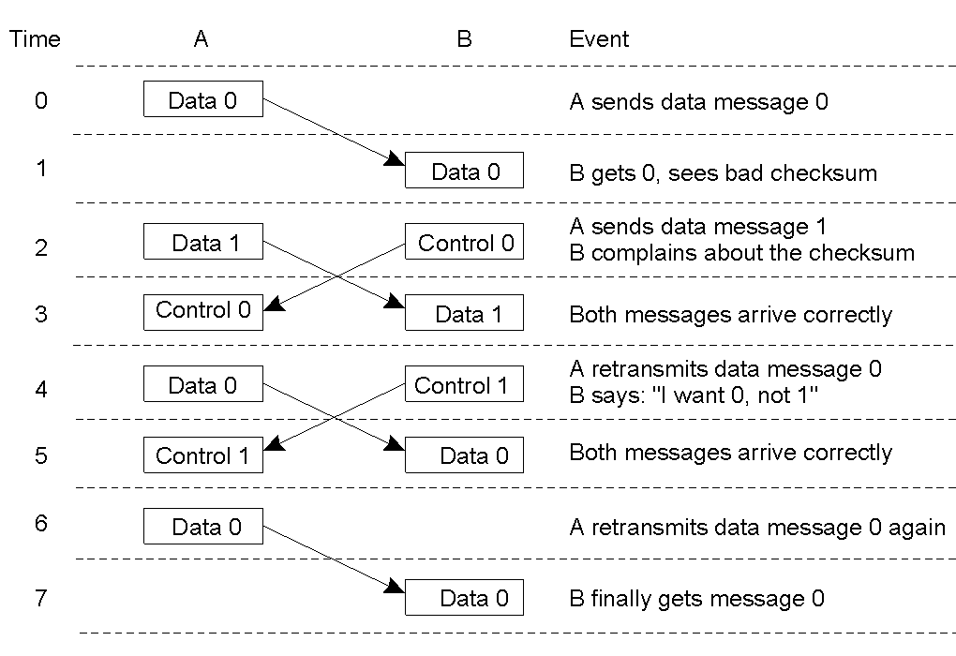
How do networks speak?
E.g. to ensure reliability: data link flow
12
Network concepts

Slide 13
How do networks speak?
The network layers seeks to move data between nodes that may not be directly connected.
Key concepts include:
using global addresses to the nodes (IPv4, IPv6)
finding a path between the nodes
routing and forwarding
13
Network concepts

Slide 14
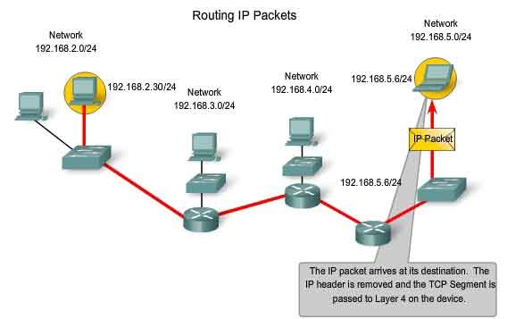
How do networks speak?
Routing is the process of finding and following a route (=path) to move the data across the network
14
Network concepts

Slide 15
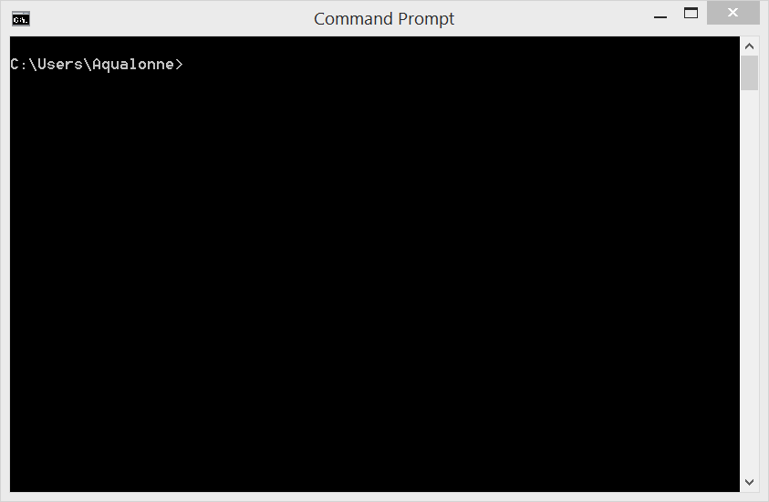
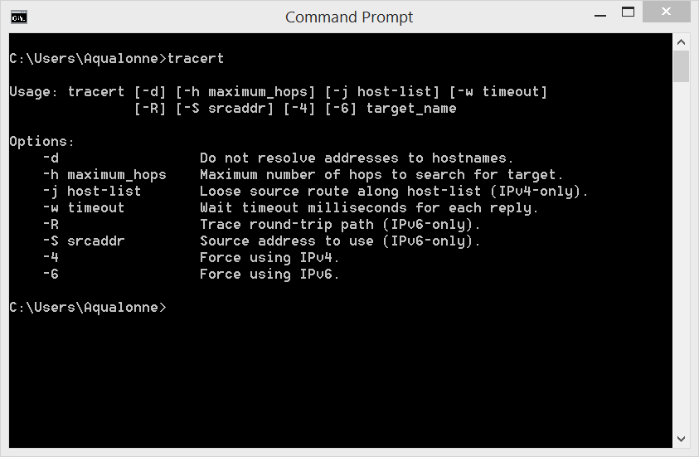
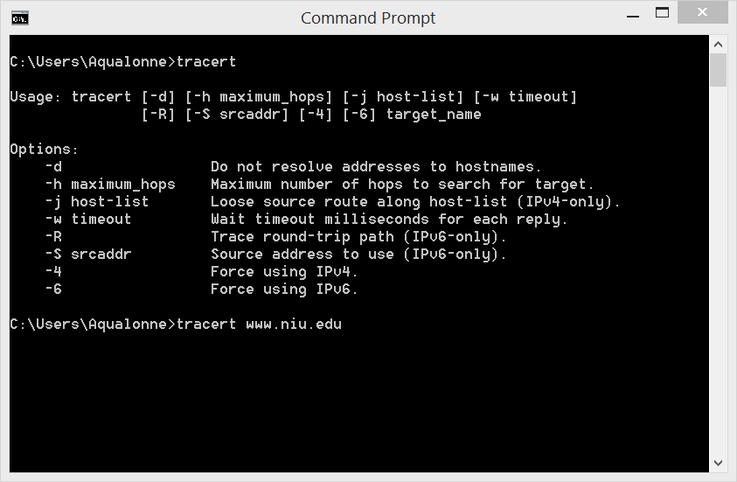
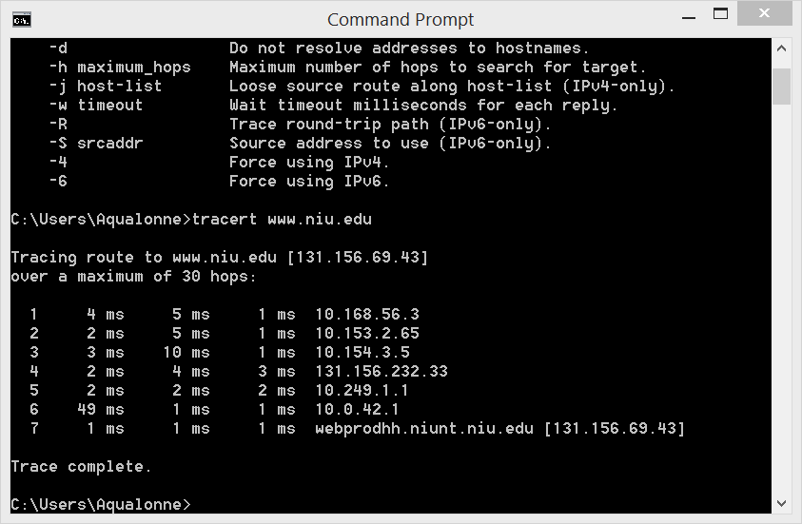
How do networks speak?
In the main OS (Linux, Windows...) you can ask to see a route
15
Network concepts

Slide 16
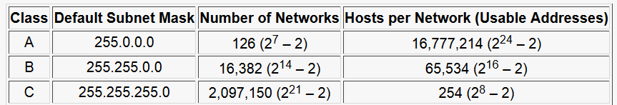

How do networks speak?
IPv4 routes a huge chunk of the traffic
Who’s got class A addresses?
General Electric (3.0.0.0)
IBM (9.0.0.0)
AT&T (12.0.0.0)
HP (15.0.0.0)
Apple (17.0.0.0)
MIT (18.0.0.0)
Ford (19.0.0.0)
Halliburton (34.0.0.0)
US Dept. of Defence (6, 7, 11, 21, 22, 26, 28-30, 33...)
16
Network concepts

Slide 17
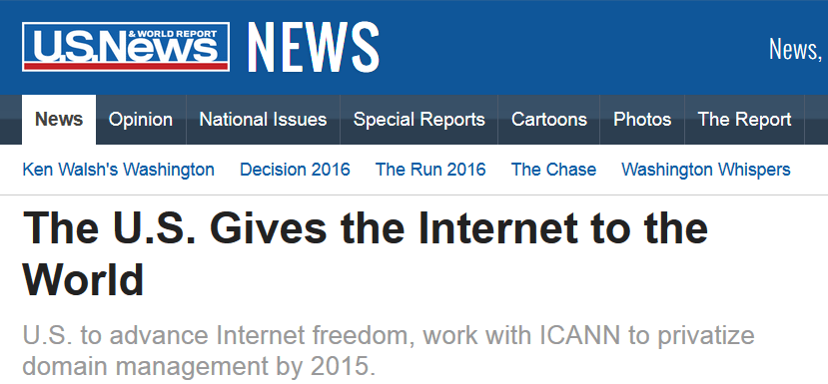
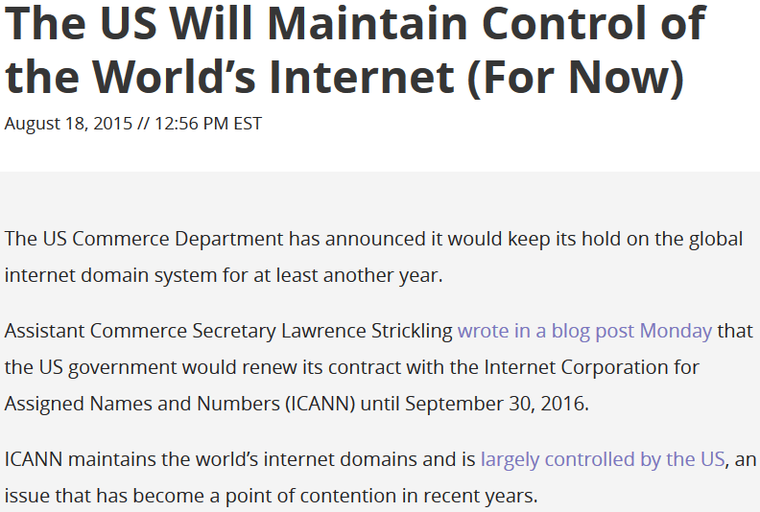
How do networks speak?
17
Network concepts

Slide 18
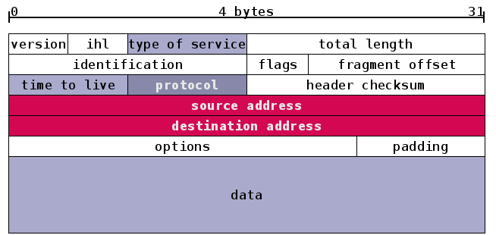
How do networks speak?
IP packet:
18
Network concepts

Slide 19
How do networks speak?
A node can have multiple endpoints depending on what you’re sending (= multiplexing). Each endpoint is a port.
0 to 1023: well-known ports
20 & 21: File Transfer Protocol (FTP)
22: Secure Shell (SSH)
23: Telnet remote login service
25: Simple Mail Transfer Protocol (SMTP)
53: Domain Name System (DNS) service
80: Hypertext Transfer Protocol (HTTP) used in the World Wide Web
110: Post Office Protocol (POP3)
119: Network News Transfer Protocol (NNTP)
143: Internet Message Access Protocol (IMAP)
161: Simple Network Management Protocol (SNMP)
443: HTTP Secure (HTTPS)
19
Network concepts

Slide 20
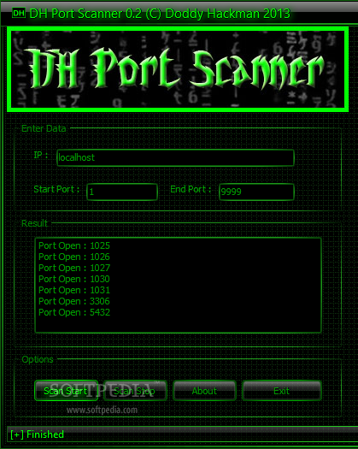
How do networks speak?
A port scanner probes a node to find open ports. We can find what services run on these ports and, if they have vulnerabilities, we can exploit them.
Doing a portscan probes a range of ports on 1 host.
Doing a portsweep probes a range of hosts for 1 port. E.g. we want to find a machine that runs SQL.
20
Network concepts

Slide 21
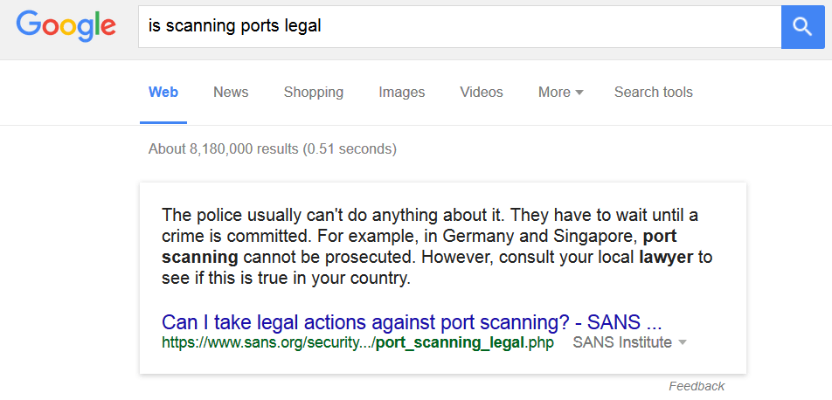
How do networks speak?
21
Network concepts

Slide 22
How do networks speak?
2 protocols are particularly important at the Transport level
UDP (user datagram protocol)
best effort
stateless (so used for a lot of clients e.g. Streaming TV)
TCP (transmission control protocol)
guaranteed delivery
can be used for stateful connections
22
Network concepts

Slide 23
How do networks speak?
Stateless vs stateful
Does no remember what the client did
Remembers
In which one of these cases do you think you should keep state information?
POP server, that allows clients to retrieve email messages that have not been previously received,
File server, that allows clients to access a given piece of data from a given file
When we speak of a “session” we generally mean stateful.
23
Network concepts

Slide 24
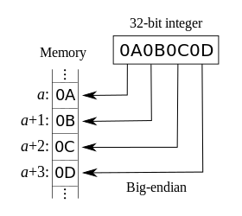
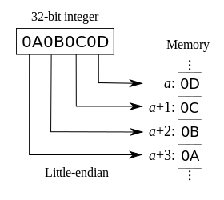
How do networks speak?
Data may be represented in two different ways. The network order is normally big-endian: the most significant bit is stored at the lowest memory address, and subsequent ones are higher.
24
Network concepts

Slide 25
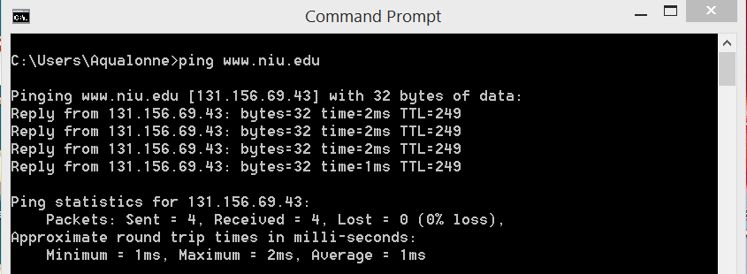
How do networks speak?
The Domain Name Service (DNS) is the internet’s primary directory service
25
Network concepts

Slide 26
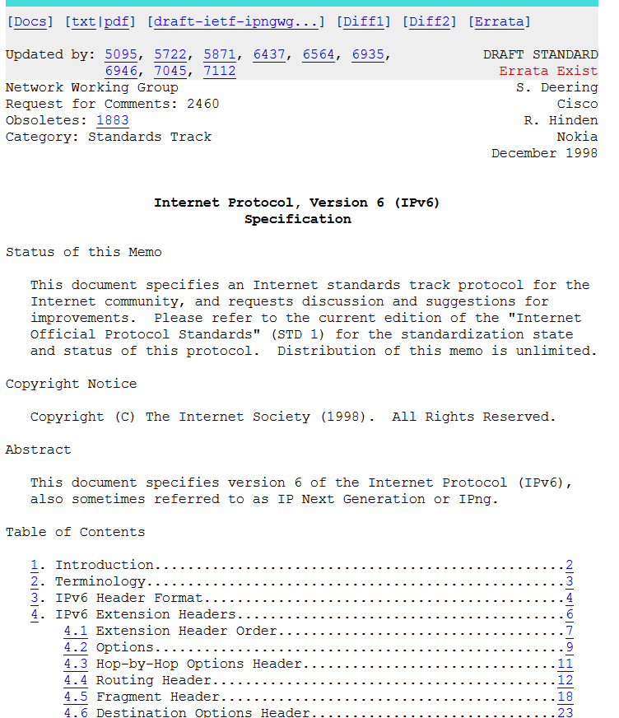
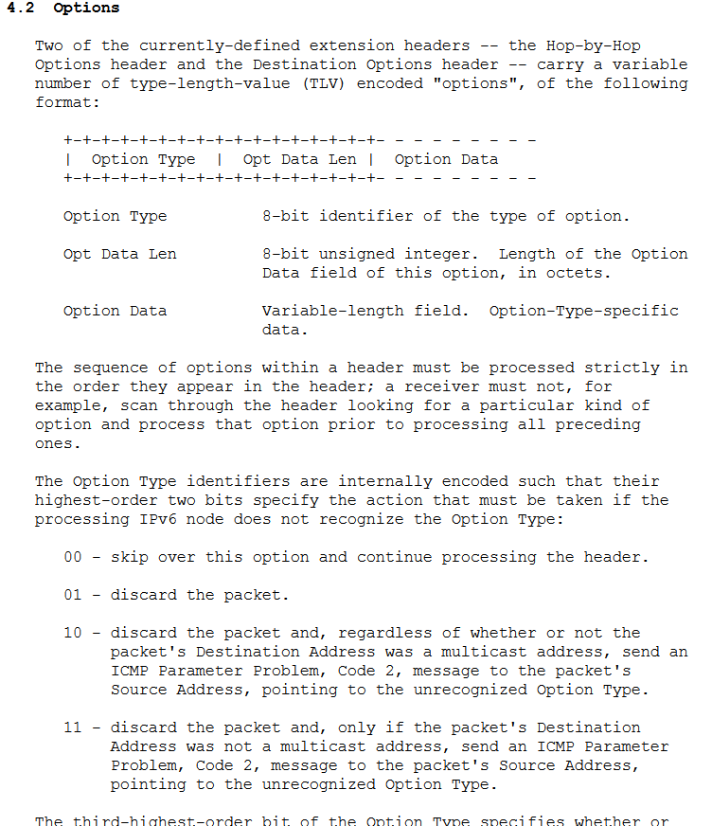
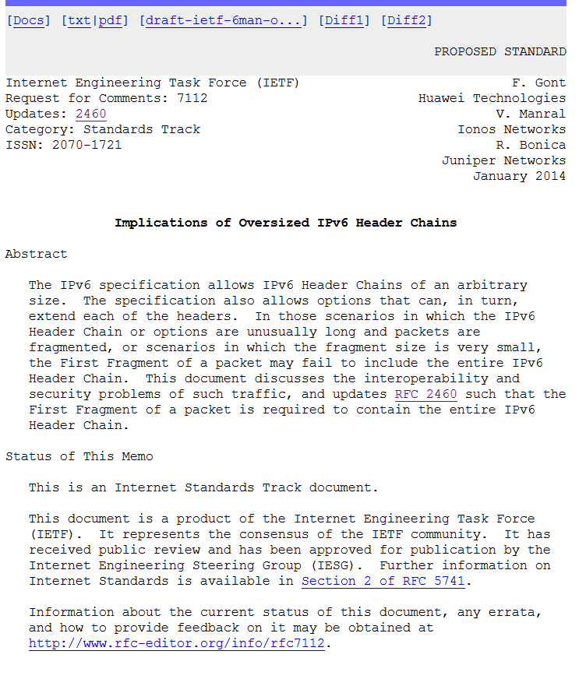
Protocols you tend to care about are described in
Request For Comments (RFC)
26

Slide 27
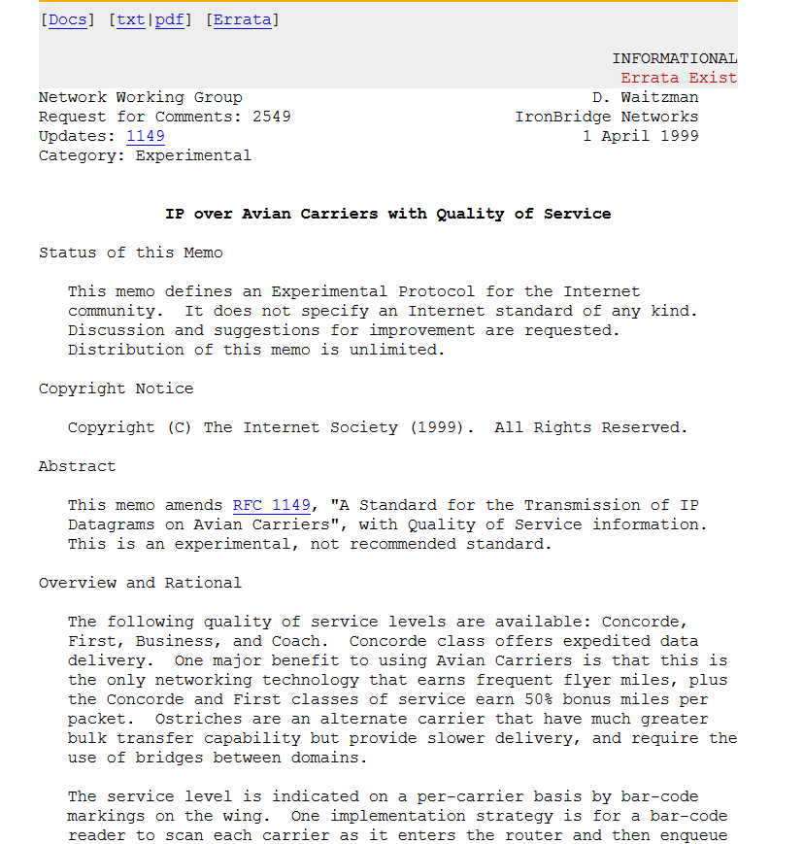
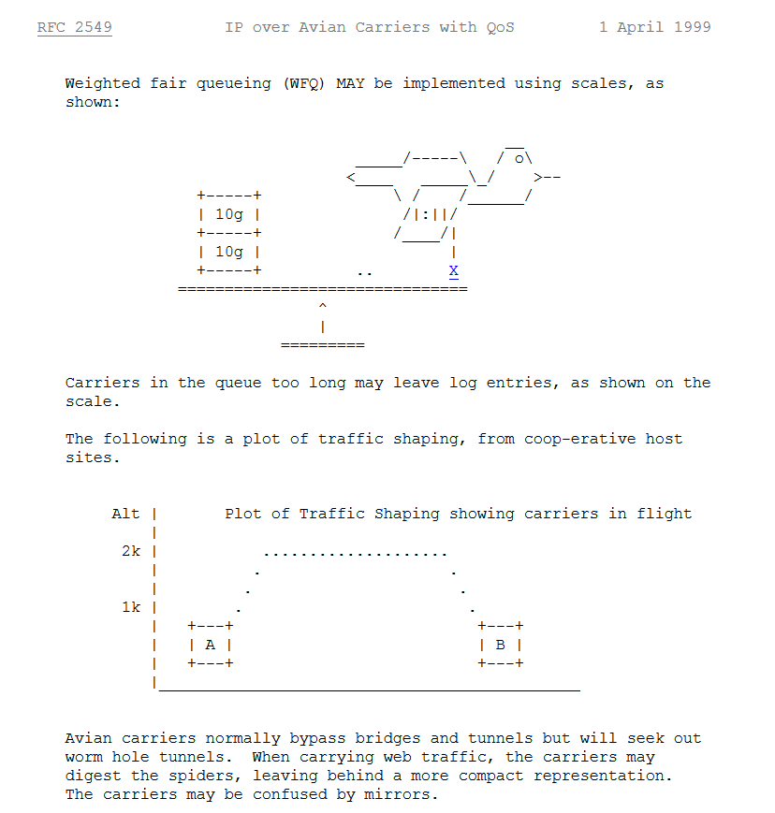
Protocols you tend to care about are described in
Request For Comments (RFC)
Some of them are jokes...
??!
27

Slide 28


Slide 29
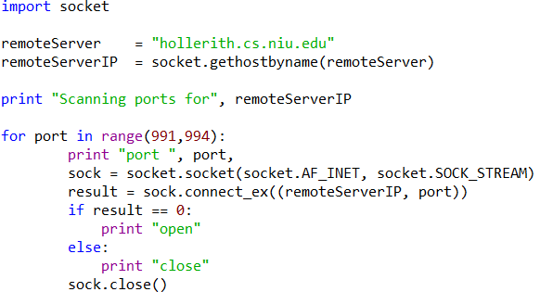
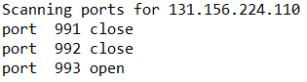
Network security
Scenario #1
What does this code do?
Uses the DNS service to get the IP from the name
This is (all you need for) a port scanner. It looks for open ports between 991 and 994 on hollerith.cs.niu.edu
A socket is how you connect: given an IP and a port, it attempts to connect
If it could connect, it means that port is open at that specific IP
29
Network concepts

Slide 30
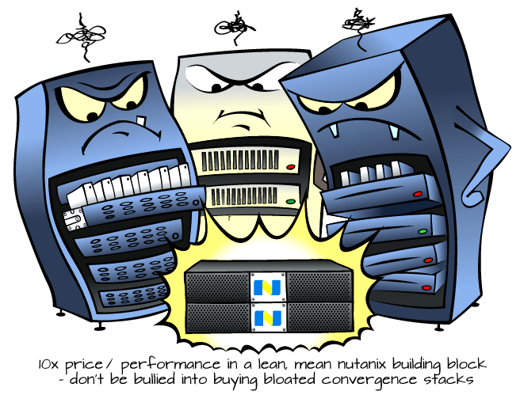
Network security
Scenario #1
What do you think will happen if you scan thousand of ports from your machine?
Security systems will notice and report that, and you may be blocked.
Why?
Because a single machine is not supposed to attempt connecting to so many ports!
30
Network concepts

Slide 31
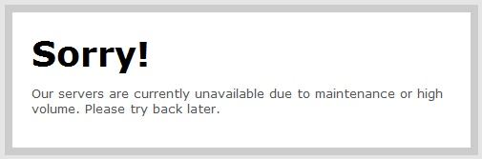

Network security
Scenario #2
Imagine that your bank really annoyed you, so you decide to crash their website. What could you try to do?
You could send MANY requests to that website so make its network busy and hope that it makes the website unavailable.
This is called a denial-of-service (DoS) attack: making a resource unavailable to intended users
31
Network concepts

Slide 32
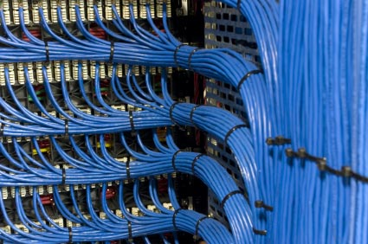
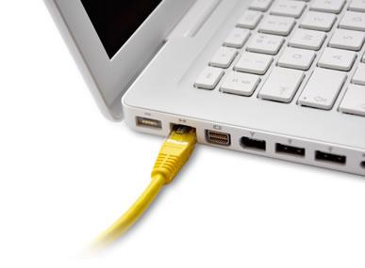
Network security
Scenario #2
What do you think will happen when you try to flood your bank’s website?
Security systems will notice and report that, and you may be blocked.
You also probably don’t have the bandwidth it takes to go bother a server...
Why?
Because a single machine is not supposed to be sending so much data within so little time.
32
Network concepts

Slide 33
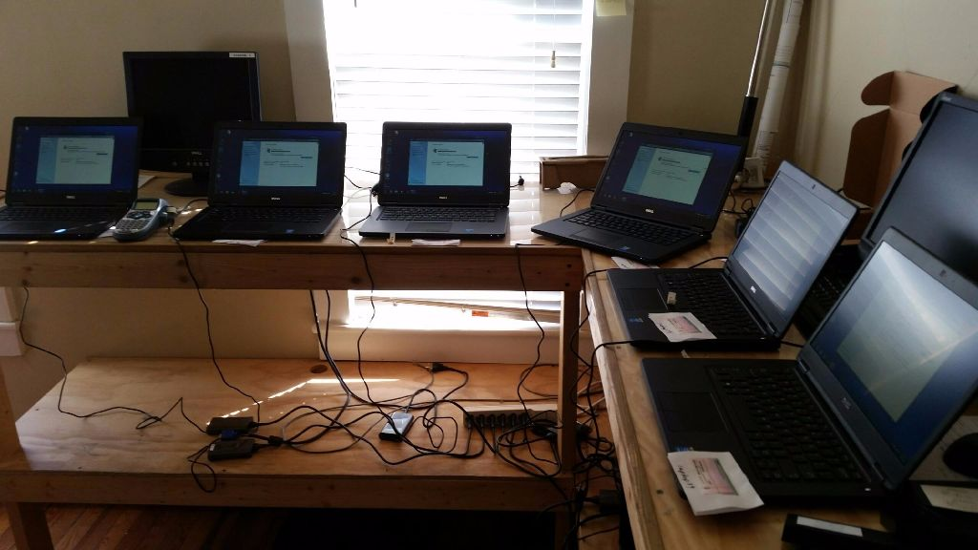
Network security
How do you prevent security from flagging your machine for doing more than it is supposed to?
Security shouldn’t be able to tell it’s the same machine! But you can’t really buy lots of little computers in order to get multiple identities...
33
Network concepts

Slide 34
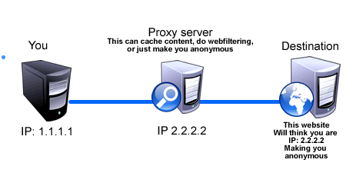
Network security
(Very) basic solution: use a proxy to hide your identity
34
Network concepts

Slide 35
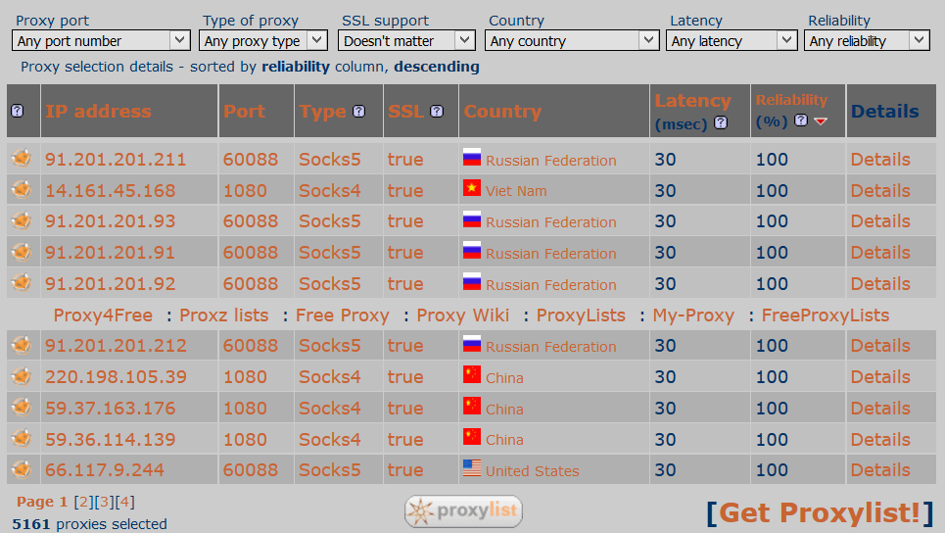
Network security
There are lists of “open proxies” online: these are proxies that anyone can use.
35
Network concepts

Slide 36
Network security
export http_proxy="http://91.201.201.211:60088" export https_proxy="https://91.201.201.211:60088” export ftp_proxy="http://91.201.201.211:60088"
export {http,https,ftp}_proxy="http://91.201.201.211:60088"
Tell the Shell to use a proxy depending on the service you use
unset http_proxy
unset https_proxy
unset ftp_proxy
Stop using a proxy
36
Network concepts

Slide 37

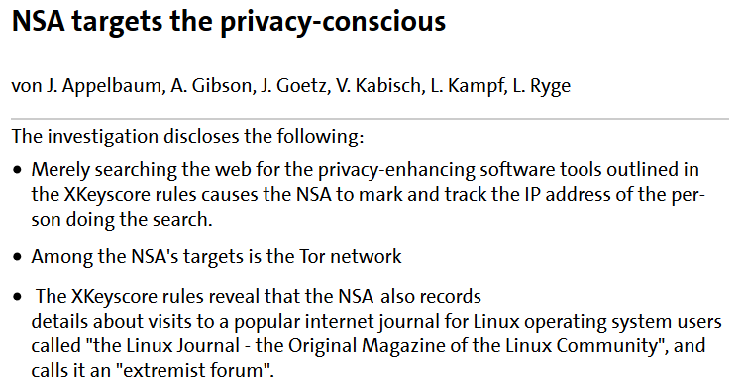
Network security
The best (free) software for anonymous communication is Tor. It encrypts data multiple times, including the destination IP, using about ≈6700 relays.
37
Network concepts

Slide 38
Network security
Being anonymous doesn’t solve the fact that you still don’t have the power to take a server down with a single machine. How can you solve that?
<
You need a lot more machines.... Where do you think you can find them?
38
Network concepts

Slide 39
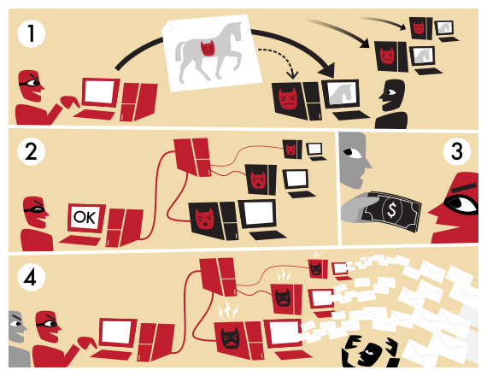
Network security
A botnet is a set of internet-connected device that complete repetitive tasks.
(1) A botnet operator sends trojans that install a bot on ordinary users’ devices
(2) The bots are ready to take order from a server
(3) The botnet is rented to hackers
(4) The many ordinary devices can now be used, particularly for volume
39
Network concepts

Slide 40
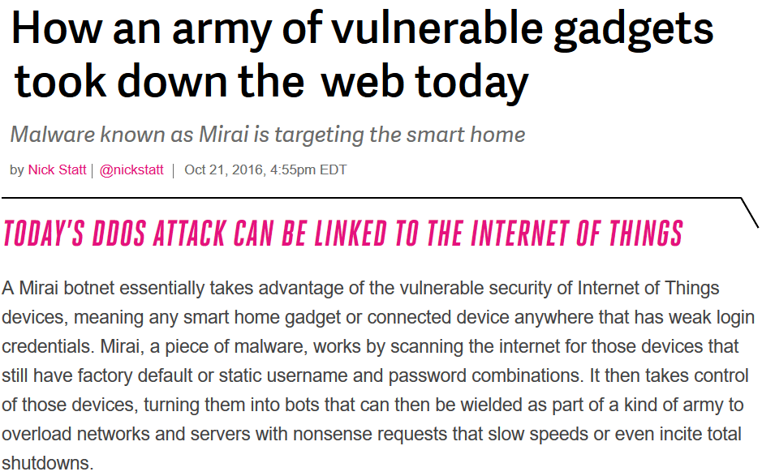
Network security
40
Network concepts

Slide 41
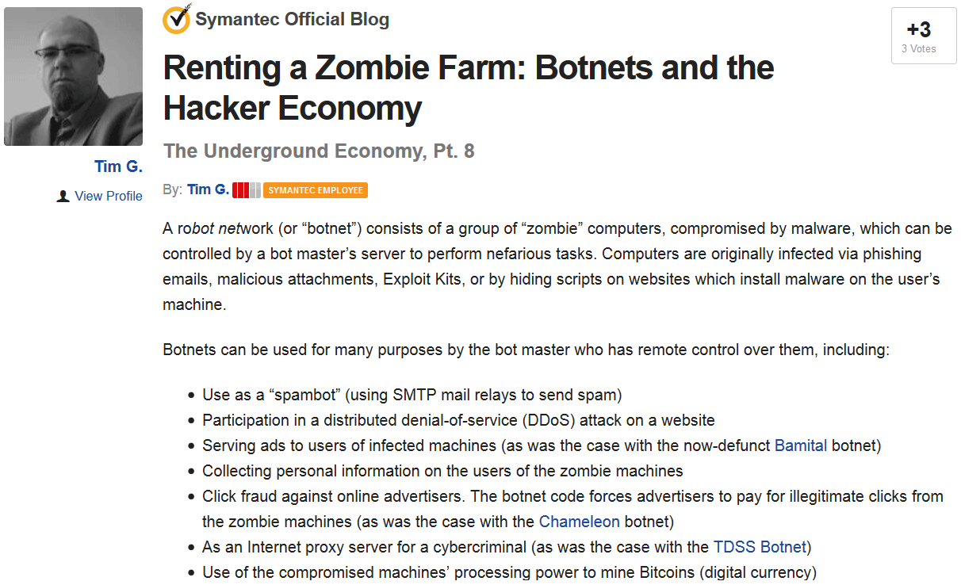
Network security
41
Network concepts

Slide 42
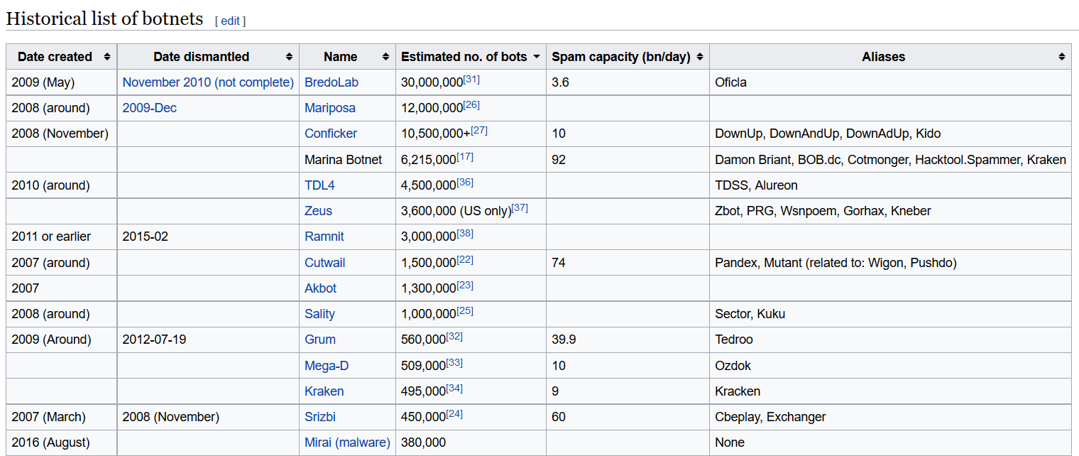
Network security
https://en.wikipedia.org/wiki/Botnet#Historical_list_of_botnets
42
Network concepts

Slide 43
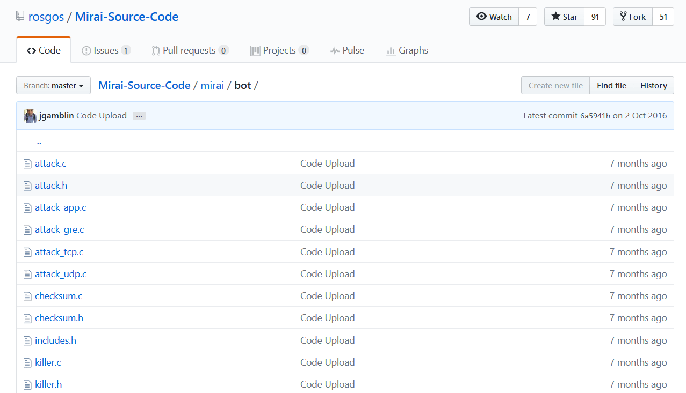
Network security
https://github.com/rosgos/Mirai-Source-Code
43
Network concepts

Slide 44

Network security
DoS
(open) proxy
Tor
Botnet / zombie farm
44
Network concepts

